Slide 1


B.Tech-Computer Engineering
Claim Management Portal
Presented By:
Dolly Mishra[IU1641050010]
B.TECH-Computer Engineering
INDUS UNIVERSITY
External Guide:
Ms. Mradima Chauhan
Software Engineer
GATEWAY GROUP
Internal Guide:
Pruthvi Patel
Lecturer
INDUS UNIVERSITY

Slide 2
CONTENT
Abstract
Project Definition
Project Features/ Functionality
Overview
Need for Application
Operating environment
Technology stack
Hardware Requirement
Work done till date

Slide 3
Abstract
Claims seem to be inevitable for most construction projects. However, the management of claims is not a simple straightforward task. The submission of claims requires some evidence to substantiate the claim, certain details to be included, some procedures (as spelled out in the contract) to be followed, and needs to be submitted within a specified time-frame. This task can be made even more complicated due to the lack of an efficient document management system and competent staff to oversee the whole process, and also the departure of key personnel in the project particularly the one who knows the most about a claim.
Without an efficient system for managing claims, disputing parties may find themselves at the losing end, as challenging the claims by an opposing party who is well prepared may prove to be difficult. Related to this, the preliminary review of existing literature does not reveal any dedicated information system developed for managing both the documentation of claims and, more importantly, the knowledge created. The lack of IT system support means that most aspects of the contract administration are done manually with most of the details residing in the head of the contract administrator, whilst the rest are distributed among the various members of staff involved in the particular project.
This web application provides a solution to the above difficulties.

Slide 4
Project Definition
Web based system which aims at processing of claims for an organization’s employees. An organisation can register their internal representative user (max of 5 representative users allowed).
These users enter details of the claim like claimant’s personal details, injury information , payment details and other related details along with the proposed payment details.
This is a US health based system.

Slide 5
Project Features/ Functionality
A simple submission process from any device:
Internal Users have the possibility to complete a short and simple form using their smartphone. Claimants’ basic info, such as first name and last name (as well as other contact information) should be filled in automatically when the customer decides to submit a claim. This should be easy to do since the info is already in the carrier’s database. In addition, the claims process will be easier if customers understand intuitively how to attach photos of receipts or invoices to their claim.
Tracking claims progress
Claimants and organization need to be able to track the status and decision of consultants regarding their claim, further steps they have to take, as well as the final outcome.
All documents in customer’s pocket
When the customer uses their insurer’s app, they need to store their paperwork such as copies of their ID, driving license and policy documents on their application.

Slide 6
Online claims payments
Clients can save a lot of time if the transaction of claims can be done online. It also adds transparency to the process because both the customer and the consultant have access to the final decision of the claim.

Slide 7
Overview
This is a web based system which aims at processing claims for an organization’s employees.
An organization can have subordinate groups. This web application has a super Admin who manages individual admin for very organization that uses the app. Every subordinate group has a admin responsible for managing max 5 internal users. These internal user collect claimant data and upload on the web application.
The claimant data includes hospital, doctor and other injury or accident related details. The admin fills an application form containing organization details. The admin needs to pay a license fee in order to use the application.

Slide 8
Need for the application
The web application provides end to end digitization
Makes the process easy and more secure for both the organization and the claimant.
The employee who claimed for medical reimbursement was required to visit the claim processing department from time to time inquiring about the status of their application. This led to wastage of the employee's valuable time in turn causing loss to the company.
Previously the claim was processed without any regulation hence causing huge loss on the company’s part.

Slide 9
Operating Environment
The web application will operate with the following Web Browsers:
Microsoft Internet Explorer version and above, Chrome, Morzilla.
Server running latest versions of IIS (Internet Information Server).
The web application can permit user access from internet connection.

Slide 10
Technology Stack
.NET
Web API
SQL
C#
HTML
Linq
KendoUI
Specialization: Wireframe, webform

Slide 11
Hardware Requirement(Developer)
1.8 GHz or faster processer, Quad-core or better recommended
2GB of RAM, 8 GB of RAM recommended(2.5 GB minimum if running on a virtual machine)
Hard disk space: minimum of 800MB up to 210GB of available space, depending upon features installed, typical installation requires 20-50GB of free space.
Hard disk speed: to improve performance install Windows and Visual Studio on a solid state drive(SSD)
Video card that supports a minimum display resolution of 720p(1280 by 720), Visual Studio will work best at a resolution of WXGA(1366 by 768) or higher
References: https://docs.microsoft.com/en-us/visualstudio/releases/2019/system-requirements

Slide 12
Software Requirements(User)
Browser
Good Internet Connection

Slide 13
Software Requirements(User)
Visual Studio
SQL Server Management Studio

Slide 14
FLOW DIAGRAMS

Slide 15
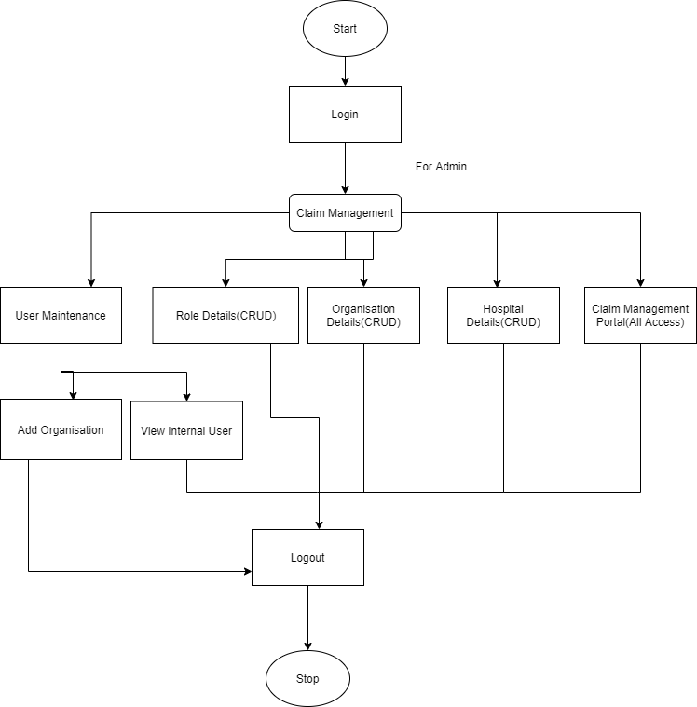
Flow diagram for admin of CMP

Slide 16
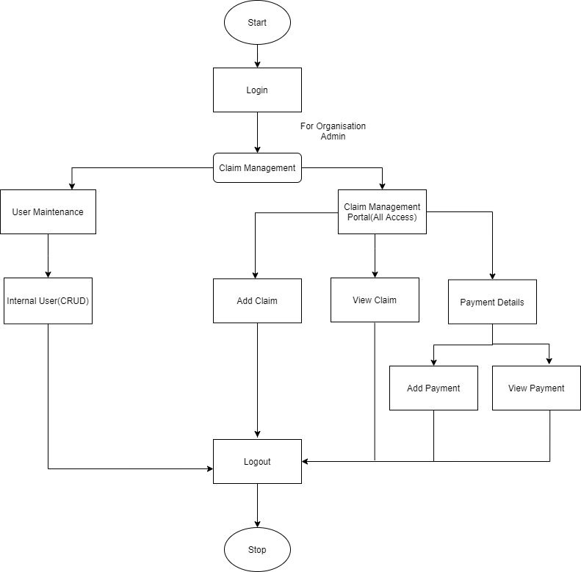
Flow diagram for Organization admin

Slide 17
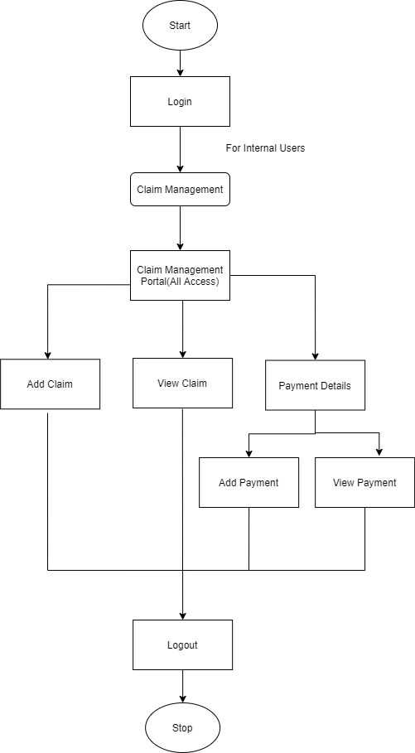
Flow diagram for Internal User

Slide 18
Work done till Date
Project Analysis
System flow diagrams
Use Case diagrams
Database flow
Screen and fields module wise
User management technique understanding
Commenced project development

